Slide 1
Intelligent ChatBot for any language using Machine Learning
Team 4 : 201923196, 201923250
Presenter 1 : Kobilov Ilkhom ( 201923250 )
Presenter 2 : Pardinov Firdavs ( 201923196 )
Advisor Professor : Tayara Hilal

Slide 2
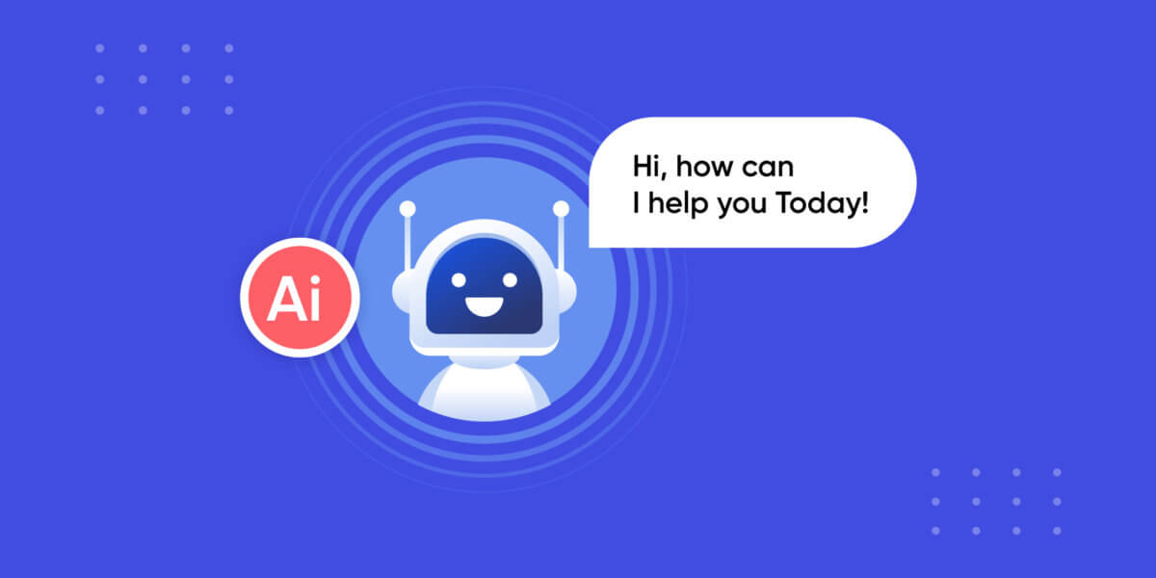

Slide 3
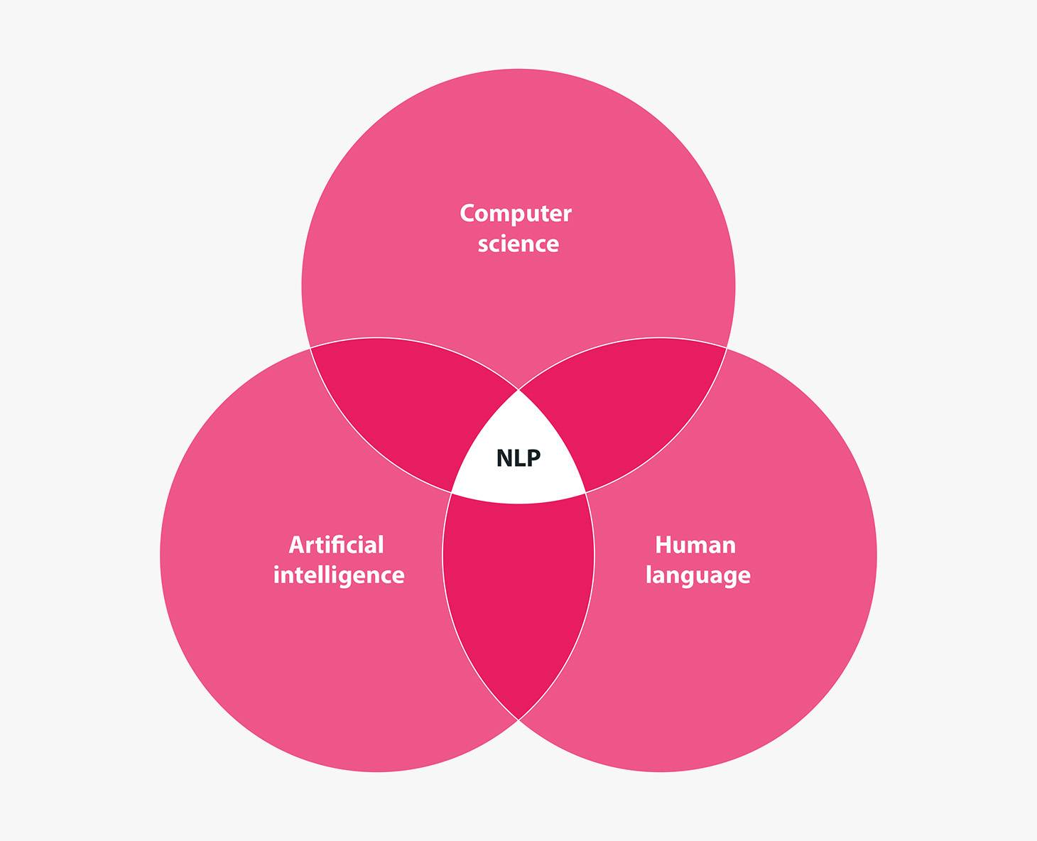

Slide 4
Technology and Libraries Used
Python
NLTK
Keras, Tensorflow, Torch
Numpy
JSON

Slide 5
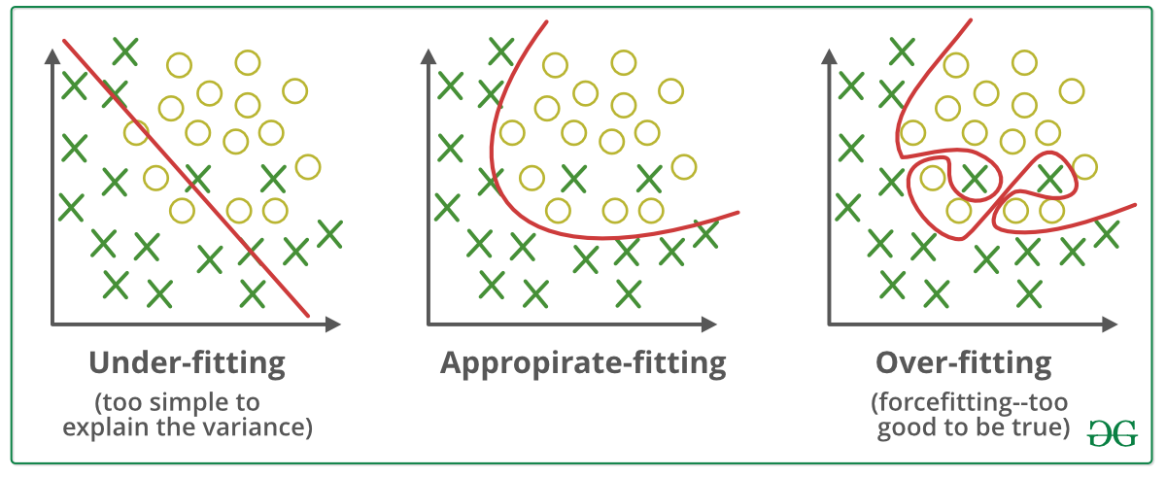
Challenges Faced

Slide 6
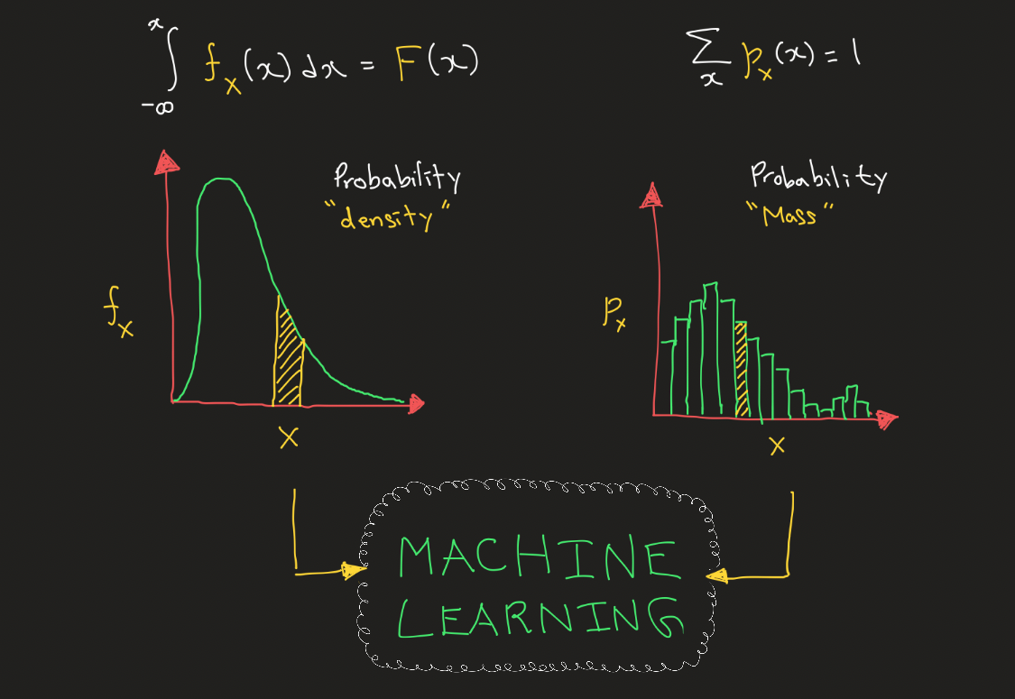
Challenges Faced

Slide 7
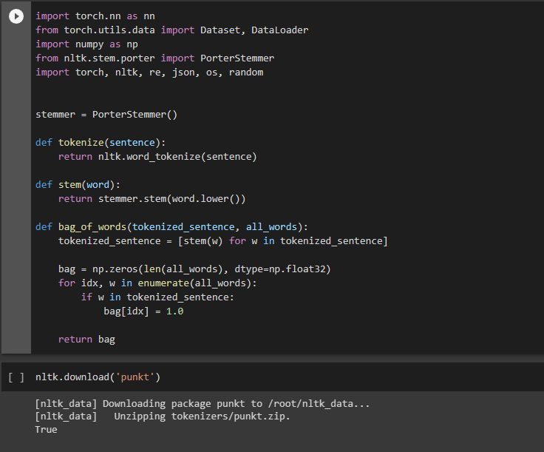
Source Code
Importing libraries & defining nltk functions

Slide 8
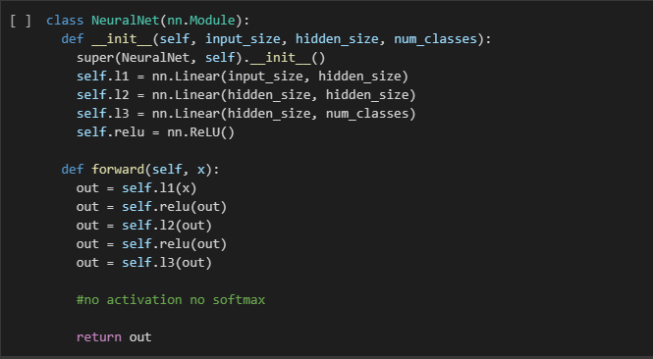
Source Code
Defining our model and activation function

Slide 9
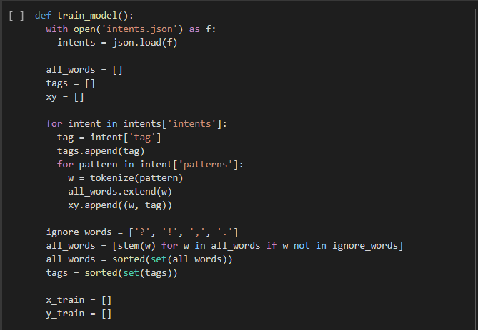
Training Function

Slide 10
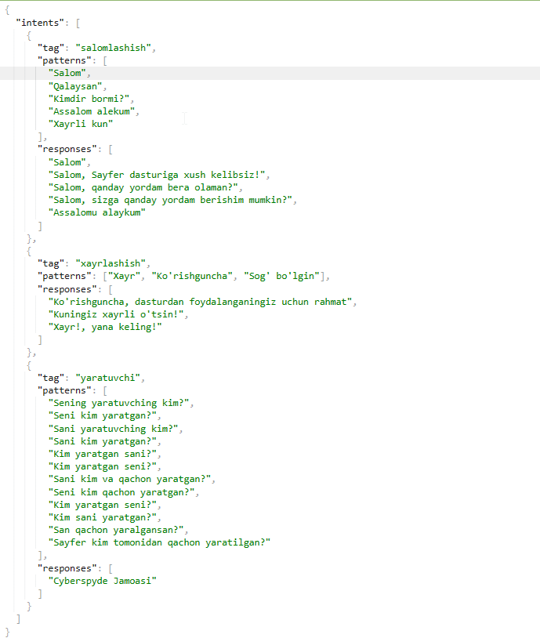
Training data

Slide 11
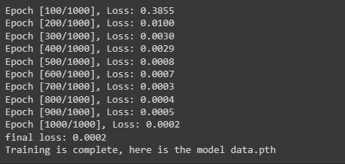
Training result

Slide 12
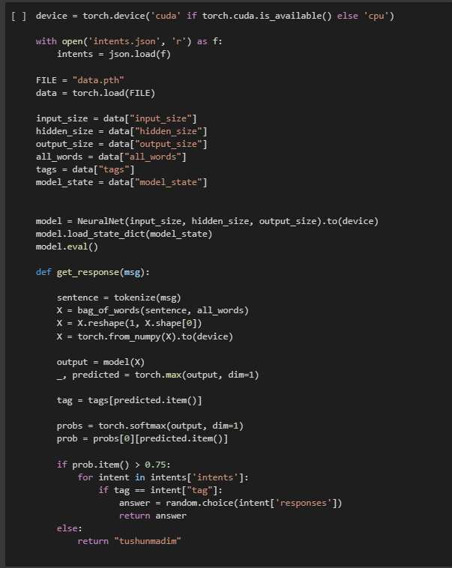
Loading and getting a response from the model

Slide 13
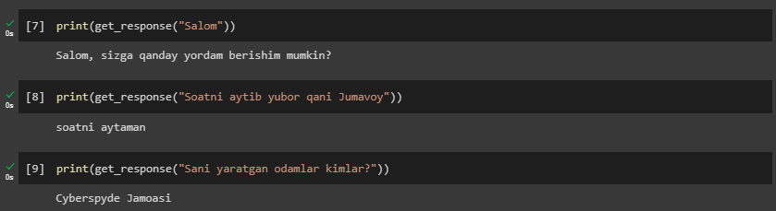
Testing & Results

Slide 14
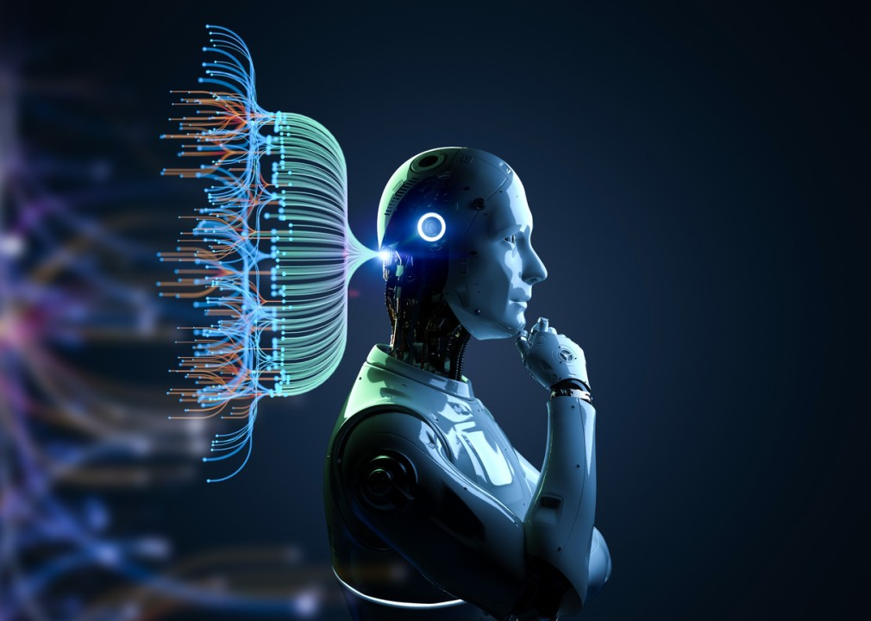
Conclusion | Beyond ChatBots

